Slide 1

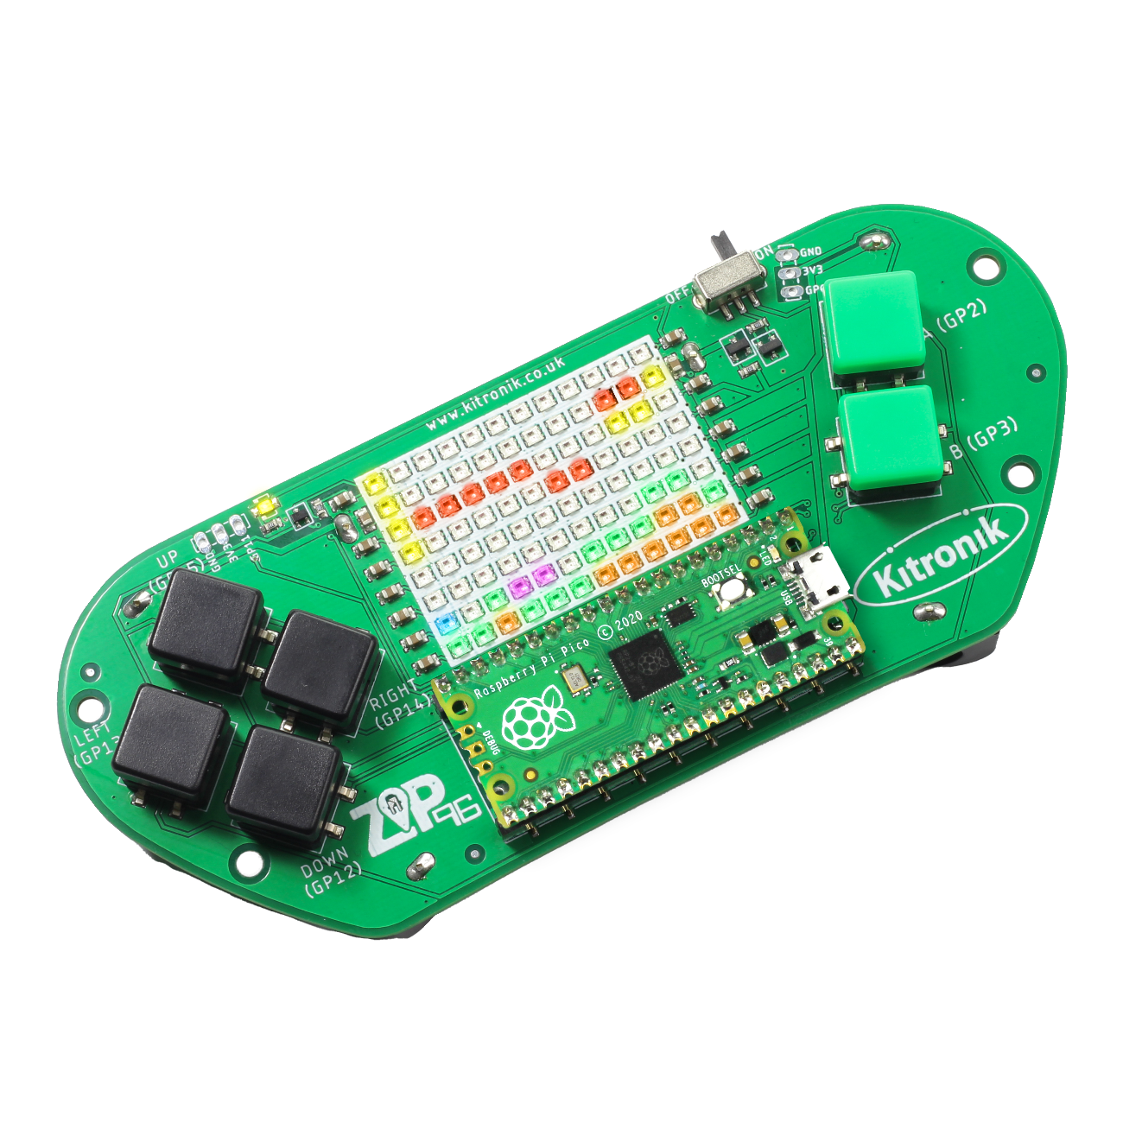
creating the a-mazing game
Computer Science

Slide 2

Aims & objectives
Computer Science
By the end of this lesson you will have:
Defined the ‘Wall’ class.
Used Wall objects to create the maze for the player to navigate.

Slide 3
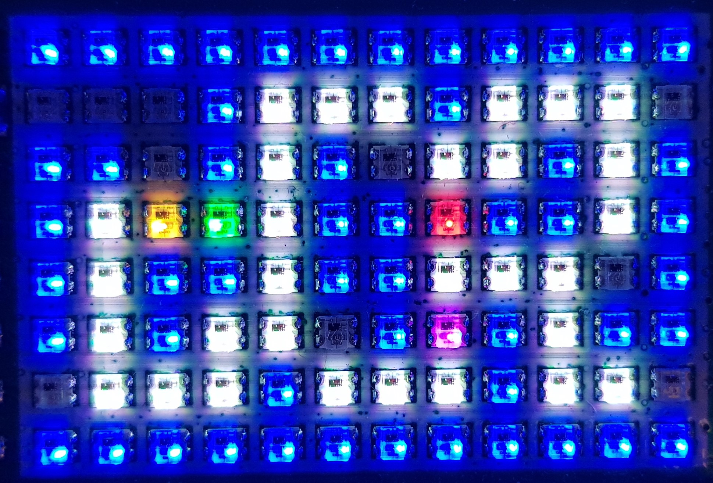
What is our a-mazing game?
Computer Science
A maze-based game where the player runs through a maze collecting gems – collect all the gems to win.
Three different enemies move around the maze as well, trying to stop the player from collecting gems.
One enemy moves randomly, one simply tries to move towards the player, the final one is smart and finds the best path through the maze to the player.
If an enemy catches the player, they lose a life. Once all three lives are lost… game over!

Slide 4
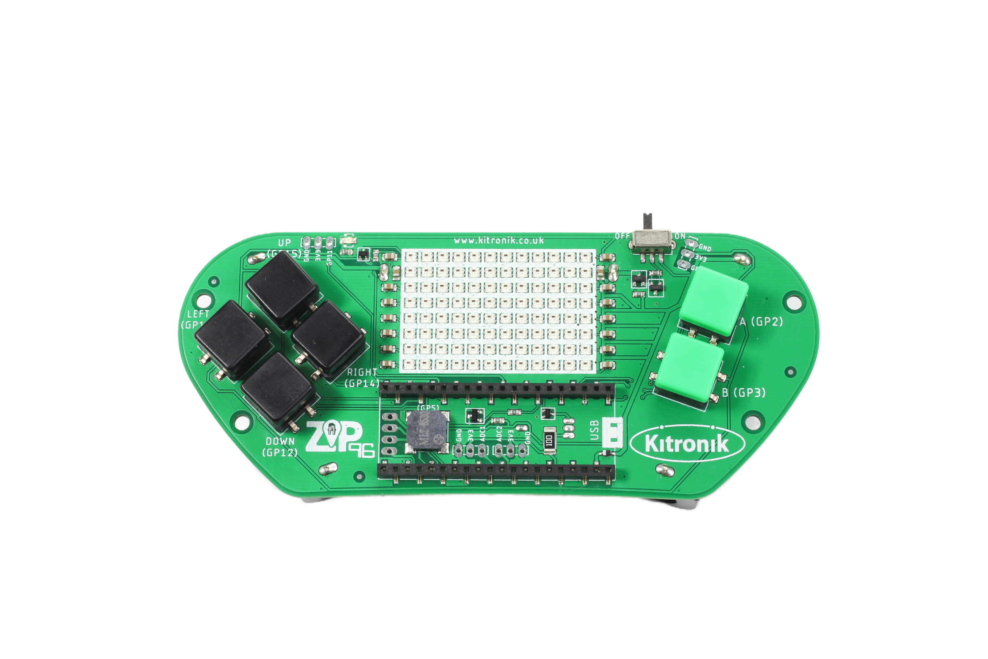
Thonny setup
Computer Science
Connect Pico ZIP96 to computer using a USB cable and open Thonny.

Slide 5
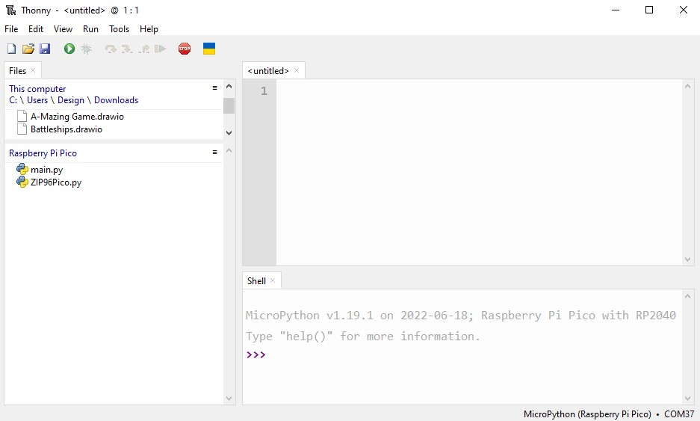
Thonny setup
Computer Science
Check the Pico device appears in the bottom right corner of Thonny.
Try pressing STOP if it does not appear automatically.
Turn on the ‘Shell’ by going to ‘View > Shell’.

Slide 6
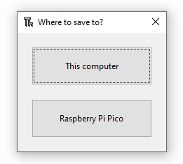
Thonny setup
Computer Science
Create a new file by clicking ‘File > New’.
Save it to the Pico by clicking ‘File > Save as’ and then select ‘Raspberry Pi Pico’.
Name the file ‘main.py’.

Slide 7
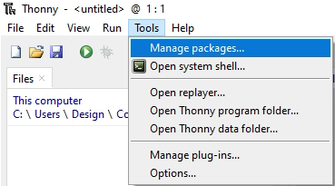
Thonny setup
Computer Science
Install the ‘ZIP96Pico’ library onto the Pico.
Click on ‘Tools > Manage Packages…’

Slide 8
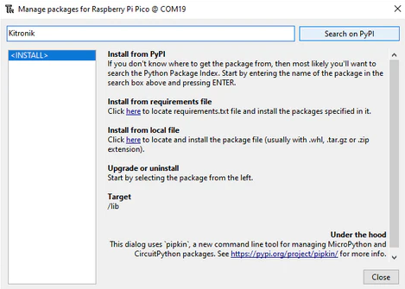
Thonny Setup
Computer Science
With the ‘Manage packages’ window open, search for ‘Kitronik’ and click the ‘Search on PyPI’ button.
Locate ‘KitronikPicoZIP96’ in the list of search results, then click the ‘Install’ button.
Confirm the install by clicking ‘Yes’ if prompted by Thonny.

Slide 9
Defining the wall class
Computer Science
What information will the Wall class need to store?
The Wall constructor will need:
its x and y position on the screen,
the colour used for the its LED,
the screen object to draw the wall on the ZIP96.

Slide 10
Coding: wall class
Computer Science
After the Player class, define the Wall class:
# Class to store our Wall functionality
class Wall():
# Wall object constructor
def __init__(self, x, y, colour, screen):
self.x = x
self.y = y
self.colour = colour
self.screen = screen
# Draw the starting position
self.draw()
# Draw the current position on the screen
def draw(self):
self.screen.setLEDMatrix(self.x, self.y, self.colour)

Slide 11
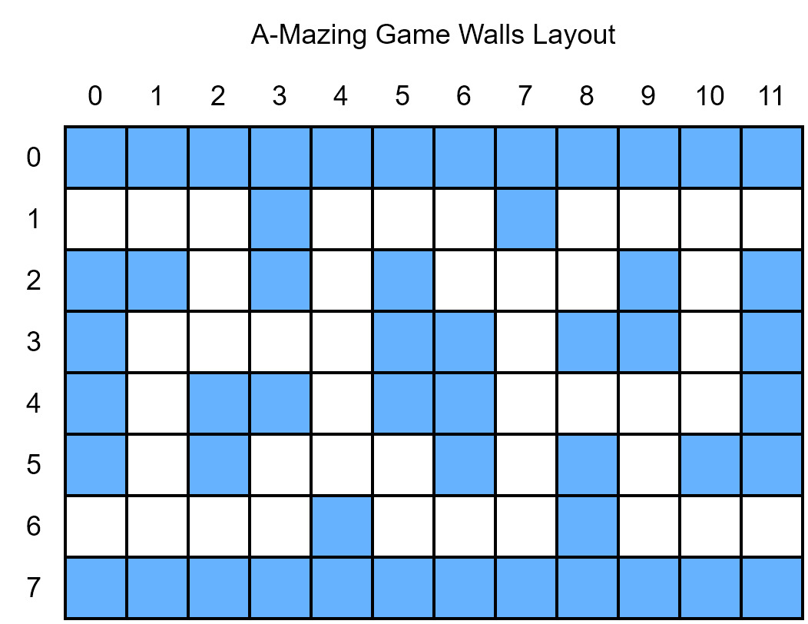
MAZE LAYOUT
Computer Science

Slide 12
Coding: WALL COORDINATE ARRAY
Computer Science
After the ZIP96Pico variables:
# List to store the coordinates of our walls
wallsXY = [(0, 0), (1, 0), (2, 0), (3, 0), (4, 0), (5, 0), (6, 0), (7, 0), (8, 0), (9, 0), (10, 0), (11, 0),
(3, 1), (7, 1),
(0, 2), (1, 2), (3, 2), (5, 2), (9, 2), (11, 2),
(0, 3), (5, 3), (6, 3), (8, 3), (9, 3), (11, 3),
(0, 4), (2, 4), (3, 4), (5, 4), (6, 4), (11, 4),
(0, 5), (2, 5), (6, 5), (8, 5), (10, 5), (11, 5),
(4, 6), (8, 6),
(0, 7), (1, 7), (2, 7), (3, 7), (4, 7), (5, 7), (6, 7), (7, 7), (8, 7), (9, 7), (10, 7), (11, 7)]

Slide 13
Coding: WALL OBJECT ARRAY
Computer Science
After the wall coordinates array:
# List to store our wall objects
walls = []
# Loop to create wall objects using the wallsXY coordinates
for wallXY in wallsXY:
# Add the wall objects to our walls list
walls.append(Wall(wallXY[0], wallXY[1], gamer.Screen.BLUE, screen))

Slide 14
Coding: add walls to player class
Computer Science
In the Player constructor:
Update player object to include ‘walls’ as a parameter:
# Player object constructor
def __init__(self, x, y, colour, walls, screen, screenWidth, screenHeight): self.x = x
self.y = y
self.colour = colour
self.walls = walls
player = Player(0, 1, gamer.Screen.YELLOW, walls, screen, screenWidth, screenHeight)
Run the program to test the maze setup

Slide 15

Coding: add walls to player class
Computer Science
What is the problem with the maze setup at the moment? How can it be fixed?

Slide 16
Coding: check for collisions
Computer Science
At the end of the Wall class:
# Check if the given x and y are the same as our current position
def collision(self, x, y):
return self.x == x and self.y == y

Slide 17
Coding: dealing with collisions
Computer Science
Just before draw() in the move() function in the Player class:
# Check each wall in our list
for wall in self.walls:
# If the player is colliding with a wall
if wall.collision(self.x, self.y):
# Undo the new position using the x and y parameters
self.x -= x
self.y -= y
# Cannot collide with more than one wall so leave loop
break
Run the program to test collisions with the maze walls

Slide 18
conclusion
Computer Science
In this lesson you have:
Created the ‘Wall’ class, its constructor and methods.
Used a for loop, if statement and Boolean logic to check for interaction between Player and Wall objects.

